Slide 1

Introduction to IBM Watson Assistant
Session 2

Slide 2
What will be covered today
What are “customer responses”
What are “action variables”
Using Customer Responses and Action Variables

Slide 3
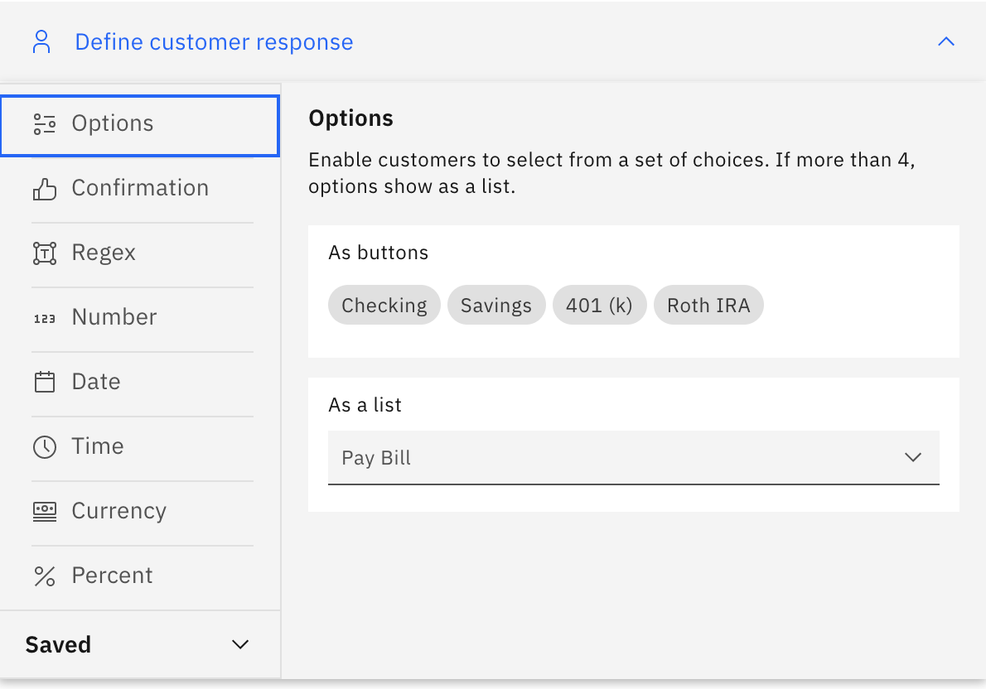
What are “customer responses”
With Watson Assistant, there are a plethora of customer responses available.
We will be focusing on Confirmation, Number, and Options today.

Slide 4
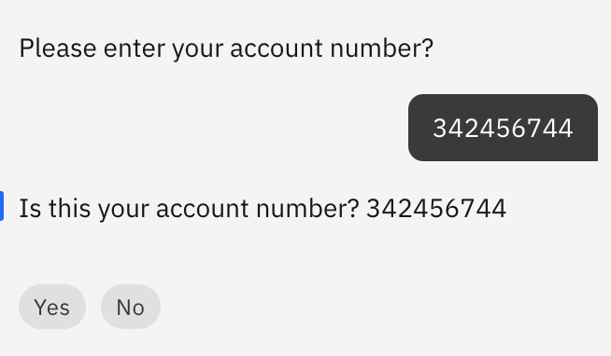
What are “action variables”
Action variables in Watson Assistant are paths to stored values defined earlier. As like variables, it would be paths to places in memory that the value is stored.
You can use this to repeat what was said by the user to verify their input.

Slide 5
Using Customer Responses and Action Variables
We will now be covering customer responses and action variables.
If you have any questions do feel free to ask me during the presentation.
A word document will be provided as well to assistant you as a recap.

Slide 6
Any questions?

